Slide 1

Binary Logistic Regression
Aksadur Rahman
aksadur@yahoo.com

Slide 2
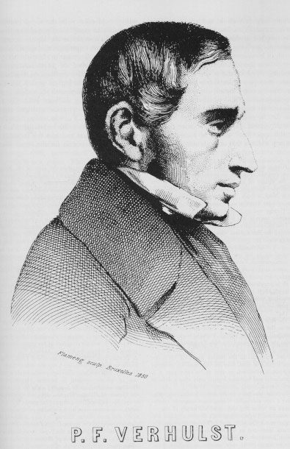
Logistic regression
Pierre François Verhulst (1804-1849)

Slide 3
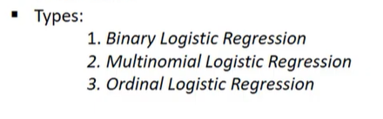
Logistic regression
Logistic regression is a process of modeling the probability of a discrete outcome given an input variable. The most common logistic regression models a binary outcome
Logistic regression, despite its name, is a classification model rather than regression model. Logistic regression is a simple and more efficient method for binary and linear classification problems. It is a classification model, which is very easy to realize and achieves very good performance with linearly separable classes.

Slide 4
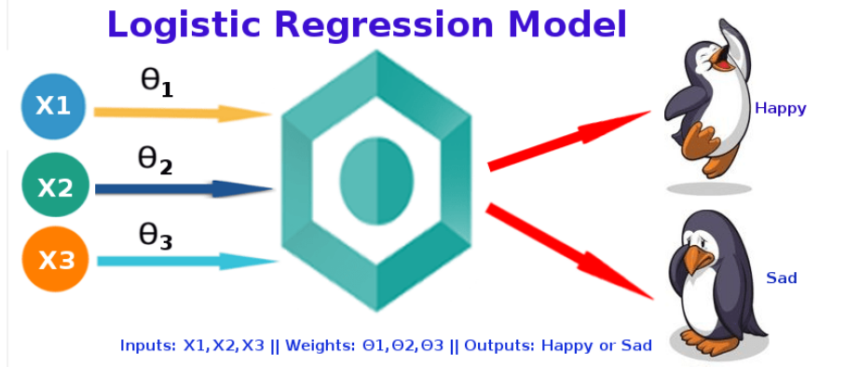
Binary Logistic regression

Slide 5
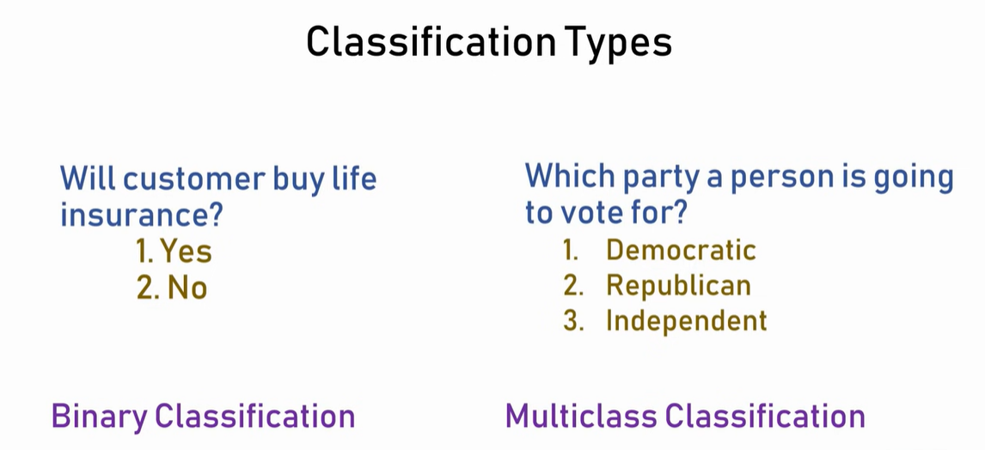

Slide 6
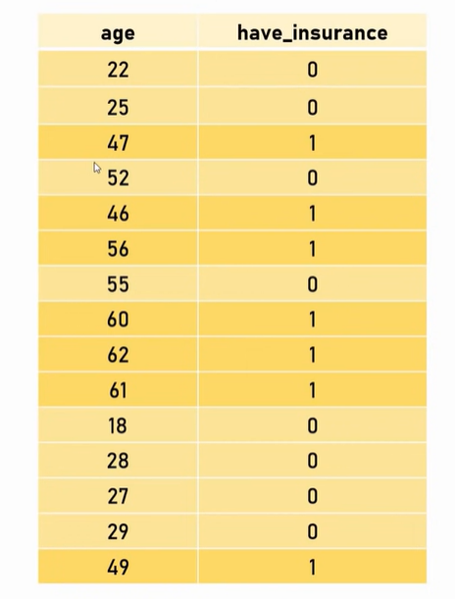

Slide 7
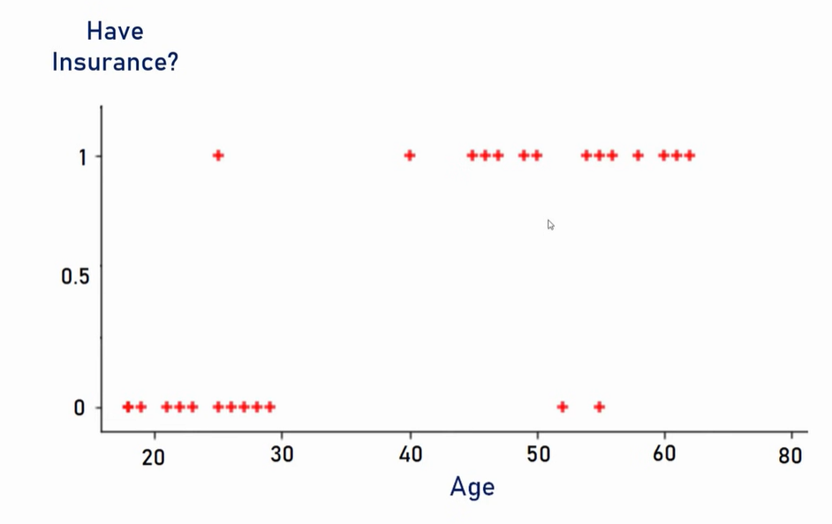

Slide 8
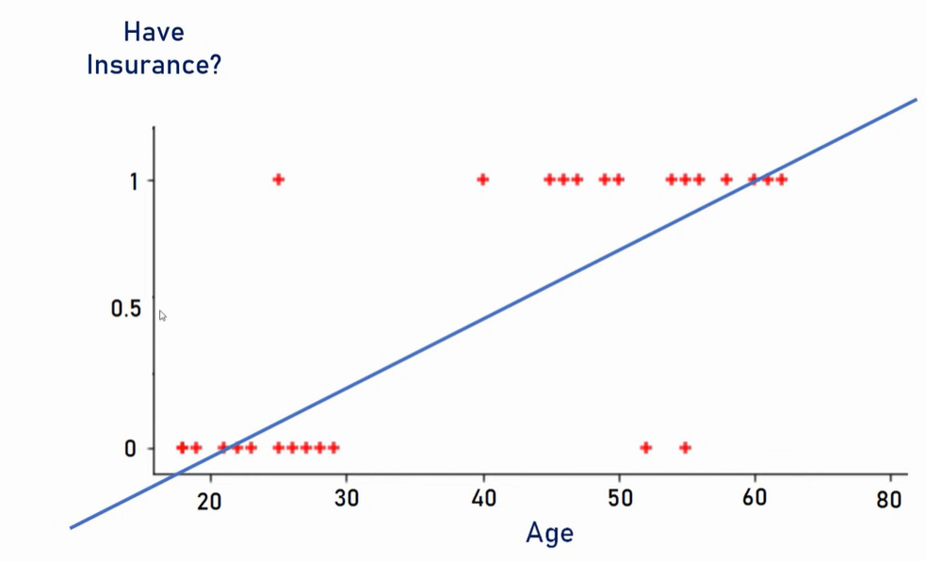

Slide 9
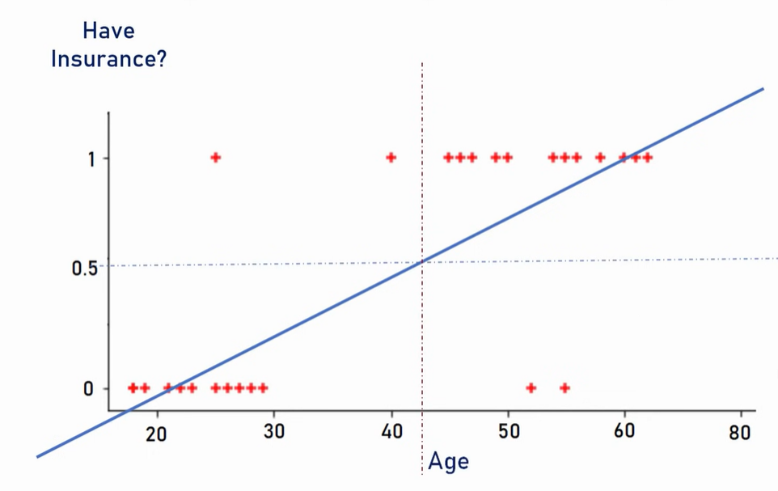

Slide 12
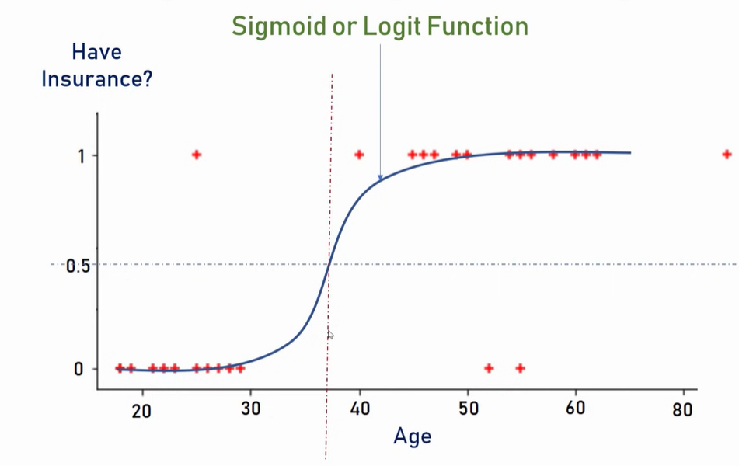

Slide 14
